Slide 1
ClimateScope
Visualizing Global Weather Trends & Extreme Events
Mentor: Shanmukha Priya
Presented by: Gaurav Chauhan
Date : 31/3/2026

Slide 2
Project Overview
Objective
Key Goals
To analyze and visualize global weather patterns using an interactive dashboard.
Identify climate trends
Detect extreme weather events
Compare regions globally
Build a decision-support system
Converts raw climate data → actionable insights

Slide 3






Project Workflow
End-to-End Pipeline
Data
Steps
Data Acquisition (Kaggle API)
Data Cleaning & Preprocessing
Analysis & Feature Engineering
Visualization Design
Dashboard Development
Deployment
Cleaning
Analysis
Visualization
Dashboard
Insights

Slide 4
Tech Stack
Core Technologies
Advanced
Python
Pandas, NumPy
Plotly (visualization)
Streamlit (dashboard)
SciPy → Forecasting
Kaggle API → Data integration
Render → Deployment

Slide 5


Data Cleaning & Preprocessing
1
2
Handle Missing Values
Remove Duplicates
Strategically addressed nulls in key fields.
Ensured unique records for accuracy.
3
4
Standardize Formats
Fix Inconsistencies
Uniform column formats and date conversions.
Corrected erroneous entries, especially location data.
Result: Clean and structured dataset ready for analysis.

Slide 6
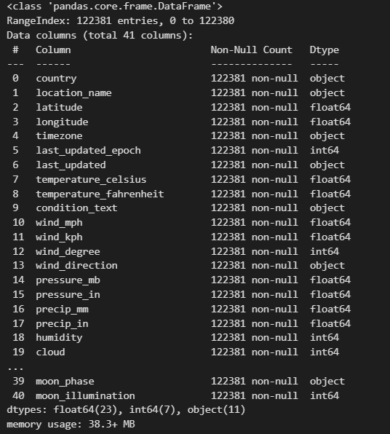
Data Preparation
Tasks
Loaded dataset
Checked structure & schema
Handled missing values
Created time-based features
Code
df = pd.read_csv("GlobalWeatherRepository.csv")
df.info()
df.describe()
df = df.dropna()
Print(df.head())
df['date'] = pd.to_datetime(df['date'])
df['year'] = df['date'].dt.year
df['month'] = df['date'].dt.month
Output: Clean dataset ready for analysis

Slide 7
Core Analysis
Tasks
Distribution analysis
Trend analysis
Regional comparison
Extreme event detection
Code: Distribution
Code: Grouping
sns.histplot(df['temperature_c'],
bins=50, kde=True)
country_temp = df.groupby("country")["temperature_c"].mean()
Extreme Events
df["is_extreme_temp"] = df["temperature_c"] > 40
Output: Patterns, trends, anomalies identified

Slide 8
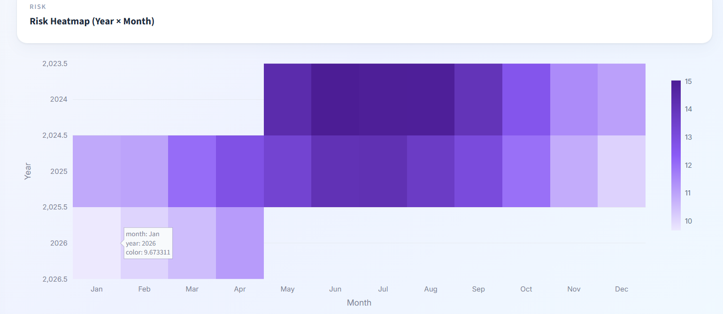
Correlation Analysis
Objective
To identify relationships between variables
Code
sns.heatmap(df.corr(), annot=True)
Insight
Temperature, rainfall, and wind show varying correlations
Helps in feature selection and risk modeling

Slide 9
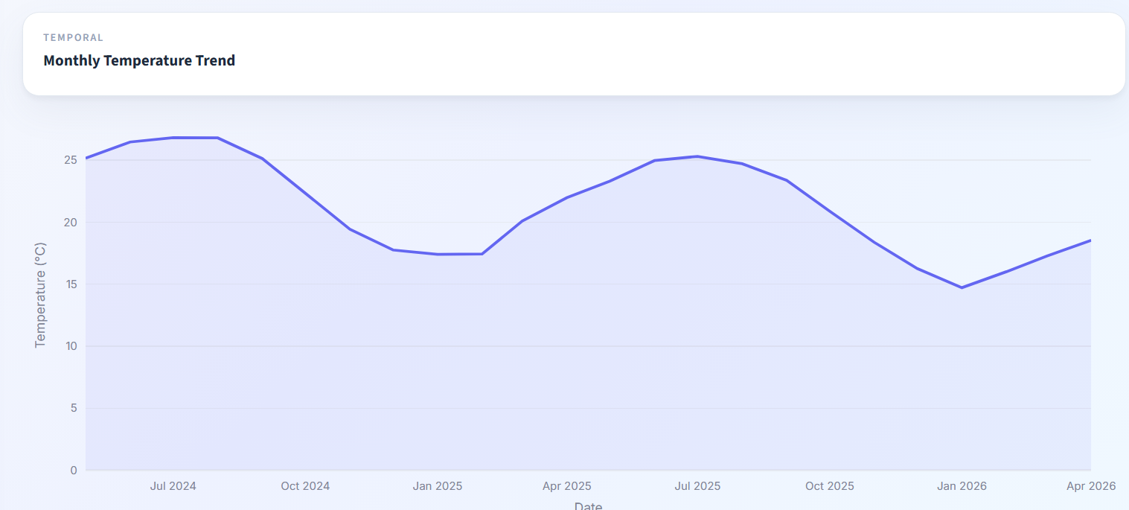
Seasonal Patterns & Trends
What I Analyzed
Monthly trends
Yearly trends
Seasonal variations
Code
monthly_avg = df.groupby(['year','month']).mean().reset_index()
Insight
Clear seasonal variations observed in temperature and rainfall

Slide 10
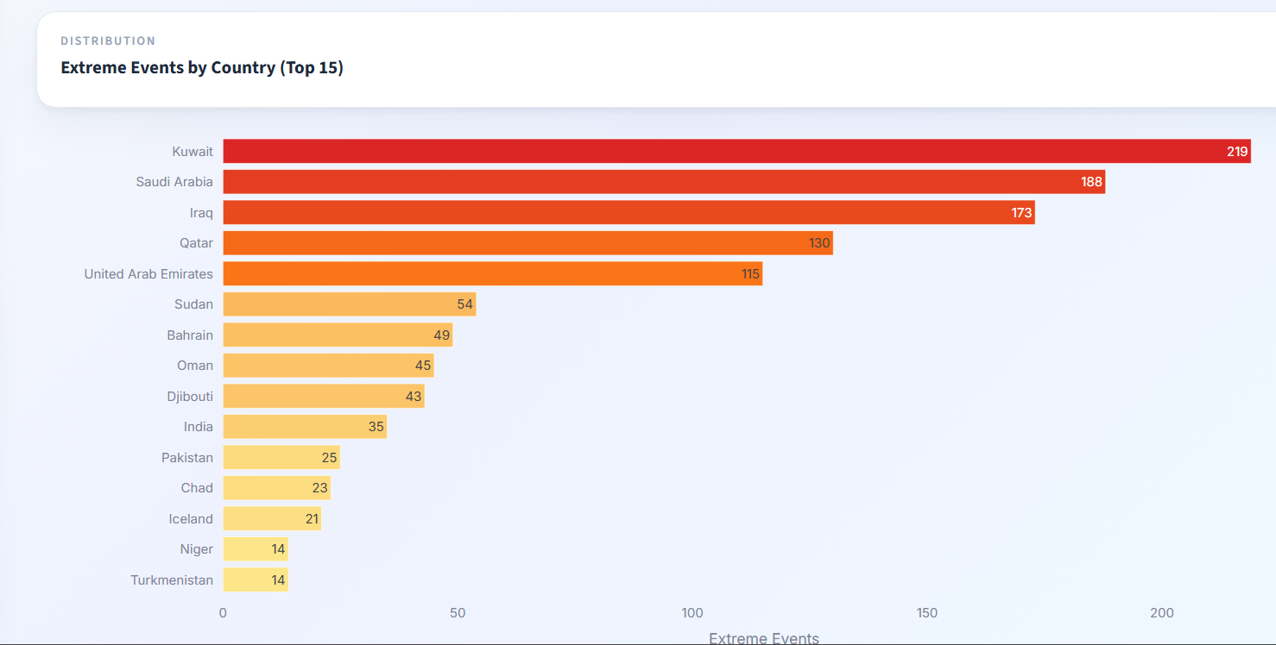
Extreme Event Identification
Logic Used
Temperature > 40°C → Heatwave
Rainfall > 100 mm → Heavy rain
Wind > 60 kph → High wind
Code
df["is_extreme"] = ( (df["temperature_c"] > 40)
(df["precip_mm"] > 100) | (df["wind_kph"] > 60) )
Outcome
Identified critical weather events and anomalies

Slide 11
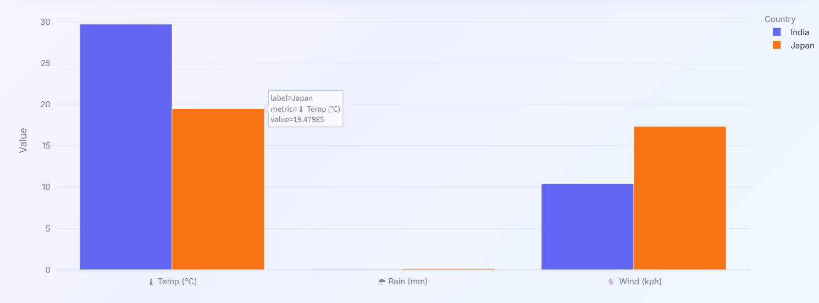
Regional Comparison
What I Did
Compared countries based on:
Temperature
Rainfall
Wind
Code
country_temp = df.groupby("country")["temperature_c"].mean()
Insight
Significant variation across regions

Slide 12
Visualization Design
Selected Charts
Choropleth Map
Line Chart
Geographic patterns
Time trends
Heatmap
Bar Chart
Seasonality
Country ranking
Code Example
px.choropleth(
df,
locations="country",
color="temperature_c"
)
Right visualization improves insights

Slide 13
Dashboard Development
What I Built
Interactive multi-page dashboard
Dynamic filters and selectors
KPI-based interface
KPI Code
Interactivity
avg_temp = df["temperature_celsius"].mean()
st.metric("Global Avg Temp", avg_temp)
country = st.selectbox("Select Country",
df["country"].unique())
Static → Interactive analytics system

Slide 14
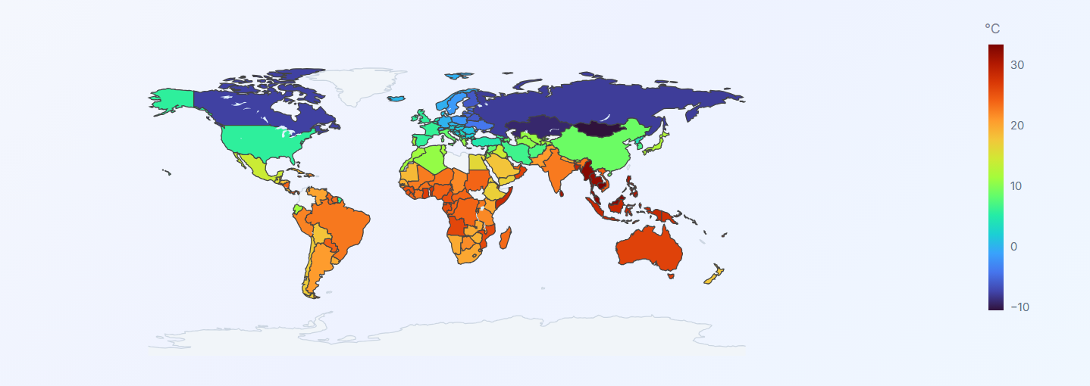
Visualization Development Tools Used
Plotly → Interactive charts
Streamlit → Dashboard interface
Visualizations Implemented
Choropleth Map → Global temperature
Line Charts → Trends over time
Heatmaps → Seasonal patterns
Bar Charts → Country ranking
Scatter Plots → Correlation
Enabled multi-dimensional data analysis

Slide 15
Interactivity Features Implemented
Controls
Country selection
Year filter
Date range selector
Multi-country comparison
Code Example
country = st.selectbox("Select Country", df["country"].unique())
Enables dynamic data exploration

Slide 16
KPI Dashboard (UI Layer)
Key Metrics Displayed
Global Avg Temperature
Total Precipitation
Avg Wind Speed
Extreme Events Count
Code
st.metric("Global Avg Temp", avg_temp)
Quick insight through KPI cards

Slide 17
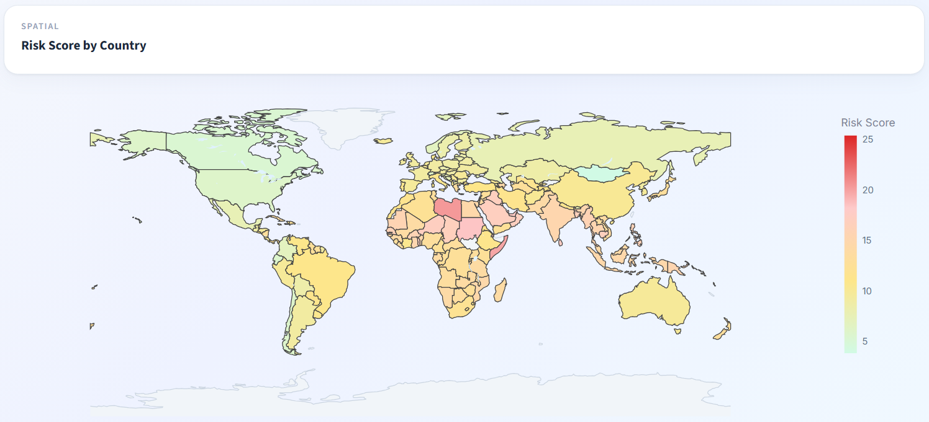
Climate Risk Model
Logic
df["risk_score"] = (
df["temperature_celsius"] * 0.4 +
df["precip_mm"] * 0.3 +
df["wind_kph"] * 0.3
)
Purpose
Combines multiple variables
Creates single decision metric
Enables risk-based analysis

Slide 18
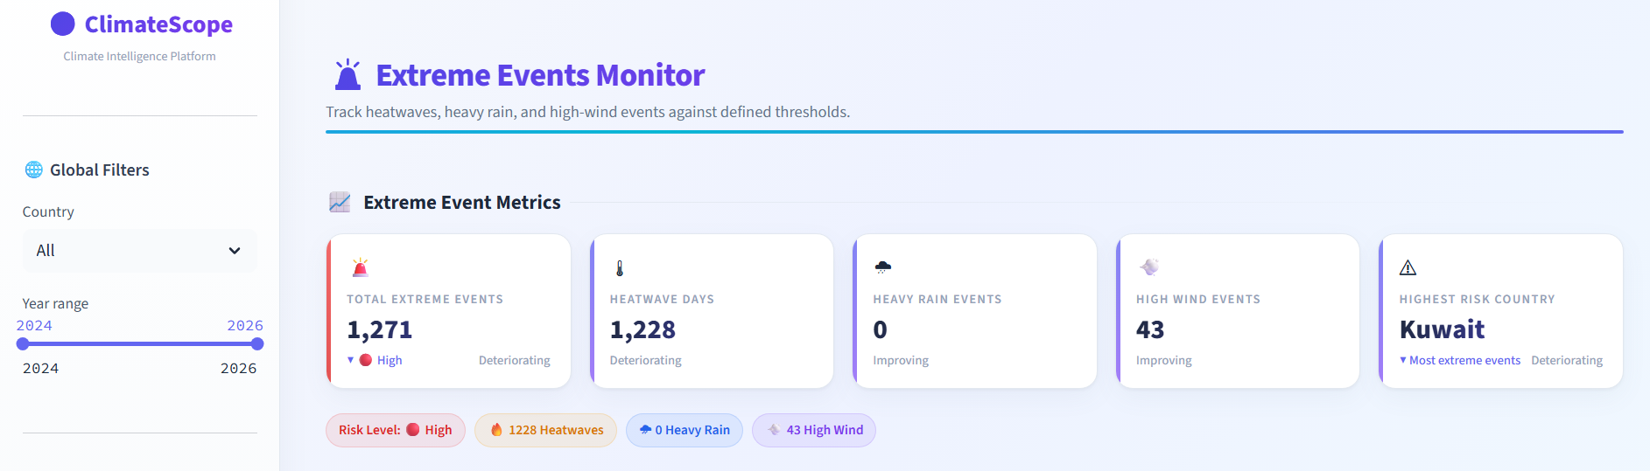
Extreme Event Detection
df["has_extreme_event"] = (
(df["temperature_celsius"] > 40) |
(df["precip_mm"] > 100) |
(df["wind_kph"] > 60)
)
Purpose
Detects anomalies
Identifies critical weather events
Converts data → actionable alerts

Slide 19
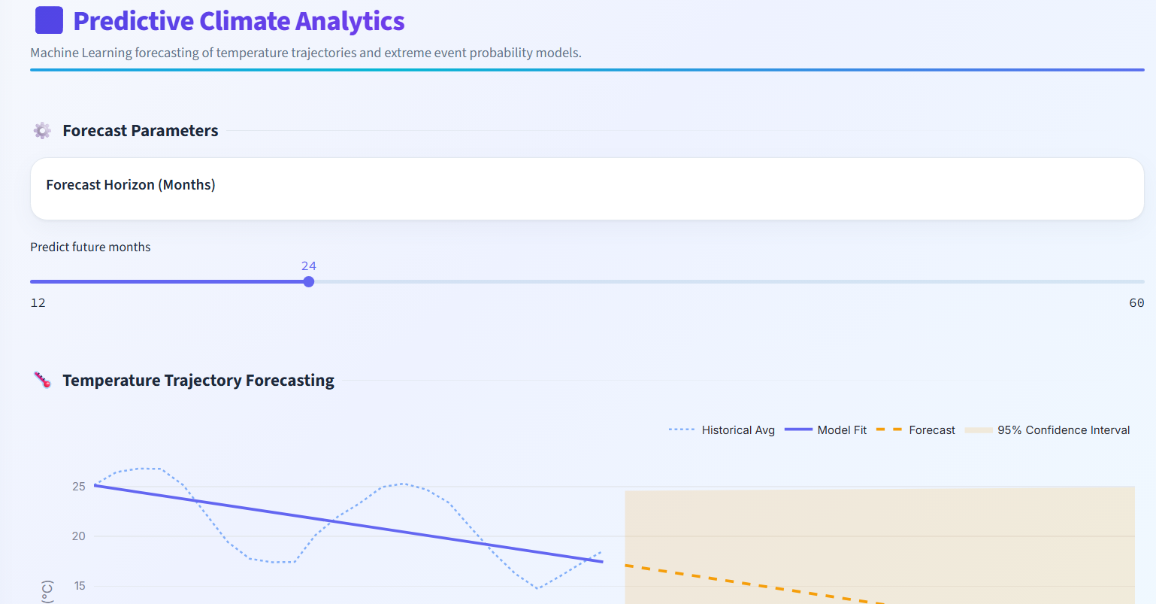
Predictive Climate Analytics
What I Added
Temperature forecasting
Polynomial regression
Code
z = np.polyfit(x, y, 2)
p = np.poly1d(z)
forecast = p(future_x)
Feature
Future prediction
Confidence interval (uncertainty cone)
Moves project from analysis → prediction

Slide 20
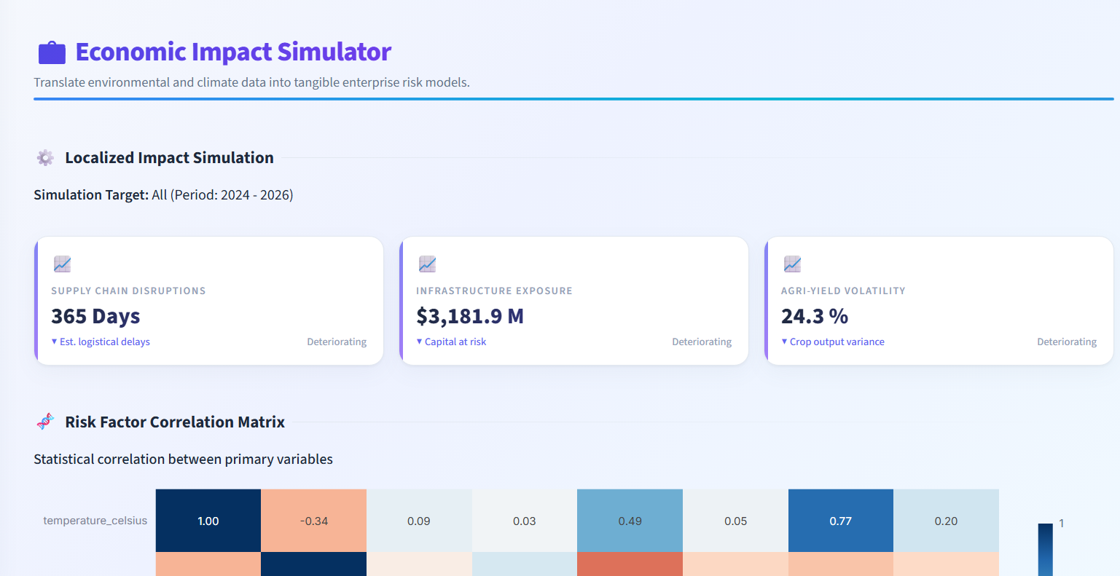
Economic Impact Model
What I Built
Business-oriented metrics
Metrics
Supply Chain Disruption Days
Infrastructure Risk
Agricultural Volatility
Code
sns.heatmap(df.corr(), annot=True)
Climate data → business insights

Slide 21
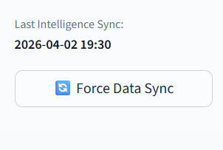
Kaggle API Integration (Real-Time Data)
What I Implemented
Automated dataset download
Real-time data updates
Code
from kaggle.api.kaggle_api_extended import KaggleApi
api = KaggleApi()
api.authenticate()
api.dataset_download_files(
"nelgiriyewithana/global-weather-repository",
path="data/",
unzip=True
)
Enables live data analysis

Slide 22
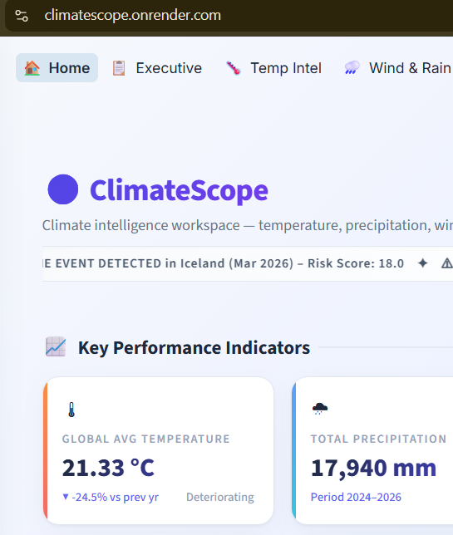
Deployment (Render Platform)
Deployment
Link https://climatescope.onrender.com/
Hosted on Render
Web-based dashboard
Features
Accessible anywhere
Scalable
Live updates
Converts project → real-world application

Slide 23
System Testing
Types of Testing Performed
Functional Testing
Data Validation
All pages working correctly
Verified calculations and outputs
UI Testing
Performance Testing
Checked layout and responsiveness
Ensured smooth execution
Ensured accuracy and reliability

Slide 24
Dashboard Validation
What Was Tested
All visualizations render correctly
Filters update charts dynamically
KPI values are accurate
Navigation across pages works smoothly
Ensures user-friendly experience

Slide 25
Insight Summarization
Key Global Insights
Temperature varies significantly across regions
Extreme heat events concentrated in tropical areas
Rainfall distribution is uneven globally
Wind intensity higher in storm-prone zones
Climate risk varies by country
Dashboard provides meaningful insights

Slide 26
Success Criteria Achieved
Dashboard is stable and bug-free
All features working correctly
Interactivity functioning properly
Insights clearly communicated
Report is well-structured
Milestone successfully completed

Slide 27
Challenges Faced
Handling large dataset
Designing intuitive UI
Implementing forecasting logic
Integrating real-time data
Deploying dashboard
Overcame through iterative development

Slide 28
Final Conclusion
Project Outcome
ClimateScope is a:
Data-driven dashboard
Interactive analytics system
Predictive platform
Business intelligence tool
Real-time application
Cloud-deployed solution
Demonstrates complete data product development

Slide 29
Thank You
.

